Slide 1

TxDOT Research Project 0-7150: Artificial Intelligence for Pavement Condition Assessment from 2D/3D Surface Images
Project Update Meeting #5
11/04, 2024

Slide 2
AGENDA
1
Tasks Overview
2
Task 5 updates
3
Future Work
4
Q & A

Slide 3
Research Tasks
Project Management
Review Literature on Pavement Condition Assessment and Artificial Intelligence
Establish a Library of Pavement 2D/3D Images in AASHTO Standard Format
Evaluate Current Practices of Pavement Condition Assessment
Develop Machine Learning Based Models for Pavement Distress Measurement
Develop Practical Tools for Pavement Condition Assessment
Pilot Study for Machine Learning Based Pavement Condition Assessment Implementation

Slide 4
AGENDA
1
Tasks Overview
2
Task 5 updates
3
Future Work
4
Q & A

Slide 5
Task 5 Description
Dataset preparation
- Image library revision
- Data analysis
Crack segmentation
- AI/ML-based models for ACP, JCP, and CRCP
Crack detection model development
- AI/ML-based models for ACP and JCP
- Comparison with PathView
* Developed tools for crack detection using standard format images

Slide 6
Image library revision
Why revision:
Barely visible distresses
Consistency

Slide 7

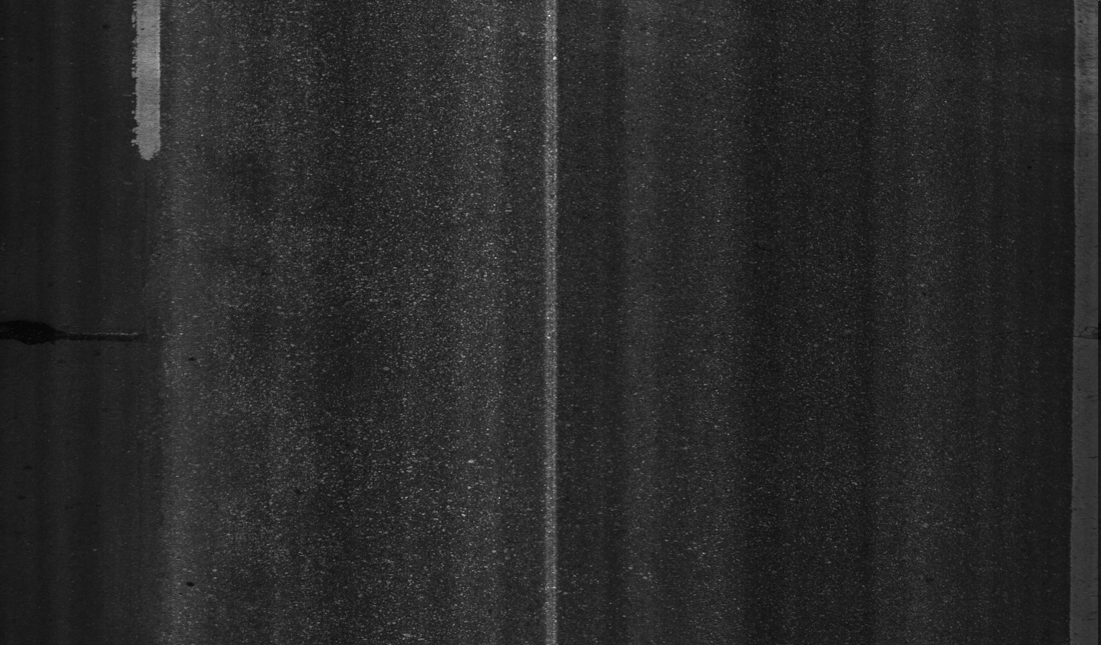

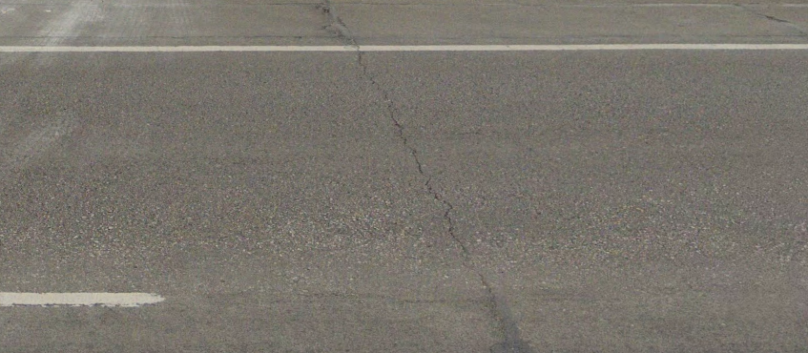

Image library revision
Cracks not been properly captured by the 2D/3D images
Collection year: 2021
Collection year: March 2021
3D image
Source: PSI data 2022
(BU0077LL_9.188_7.413)
2D image
Source: PSI data 2022
(BU0077LL_9.188_7.413)
Google Street View
31°32'36.6"N 97°06'31.0"W

Slide 8
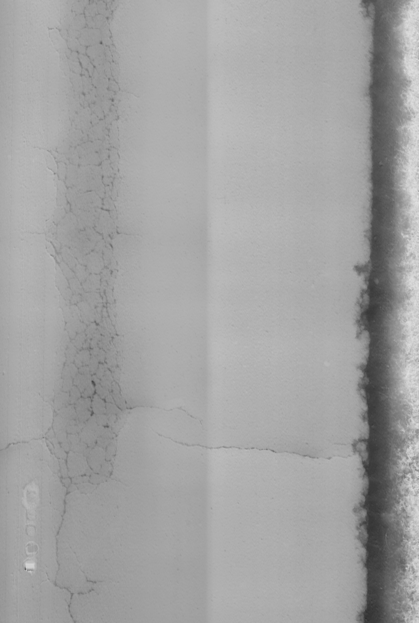

Image library revision
The unfixed spatial ratio may impact the identification of certain distress classes such as Transverse crack
PSI ratio
Transverse resolution 2.75 mm
Longitudinal resolution 6.97 mm
Actual spatial ratio

Slide 9
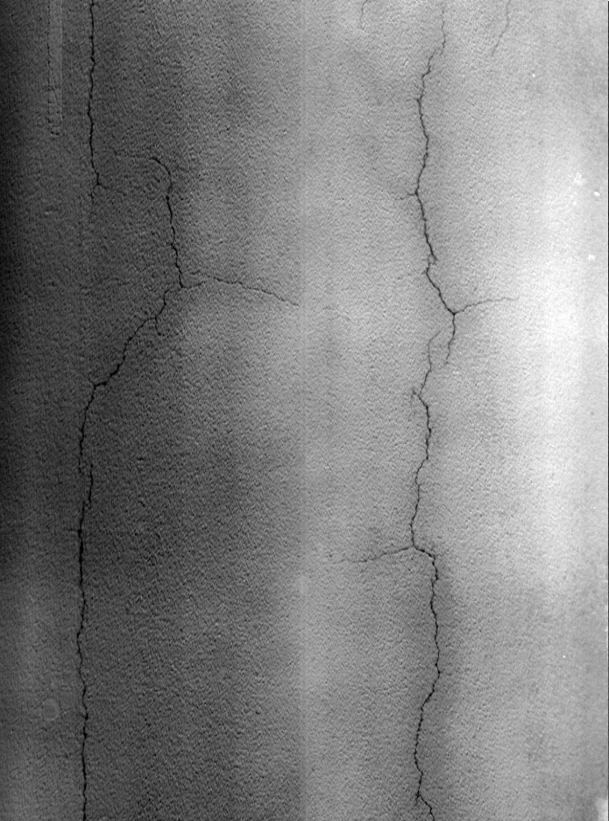
Image library revision
Why revision:
Different interpretation by individual annotators
3D image

Slide 10
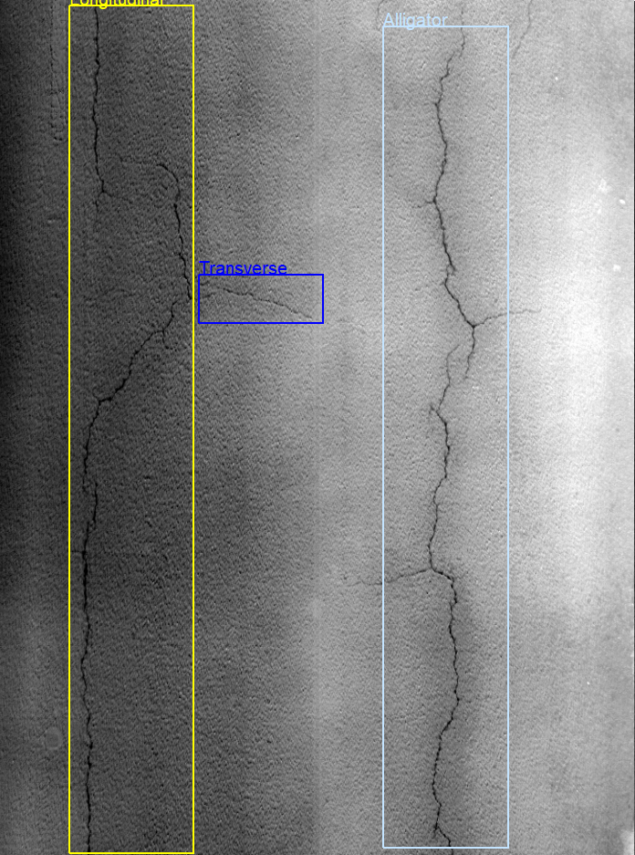
Image library revision
Why revision:
Different interpretation by individual annotators
Annotation 1

Slide 11
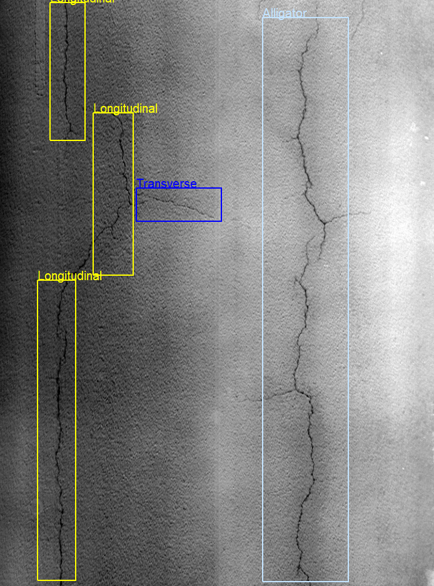
Image library revision
Why revision:
Different interpretation by individual annotators
Both annotations are correct but detection results could be very different
Annotation 2

Slide 12
Image library revision
Why revision:
Barely visible distresses
Consistency
Strategy:
Removed ambiguous annotation
Modified bounding boxes

Slide 13
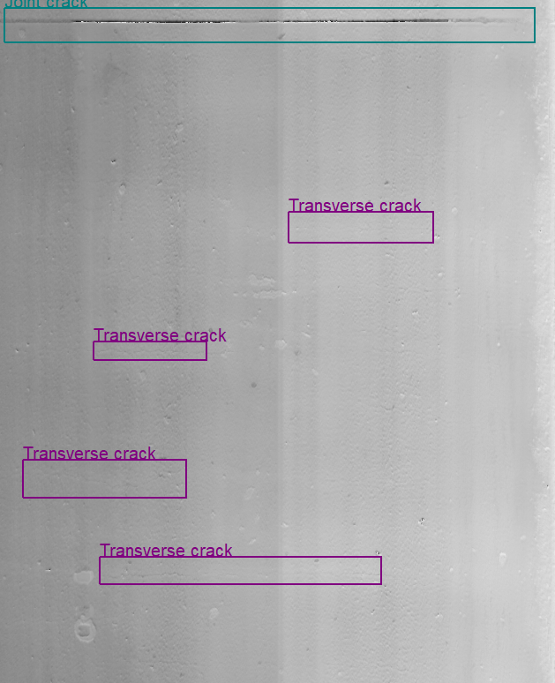

Image library revision
Before revision
After revision

Slide 14
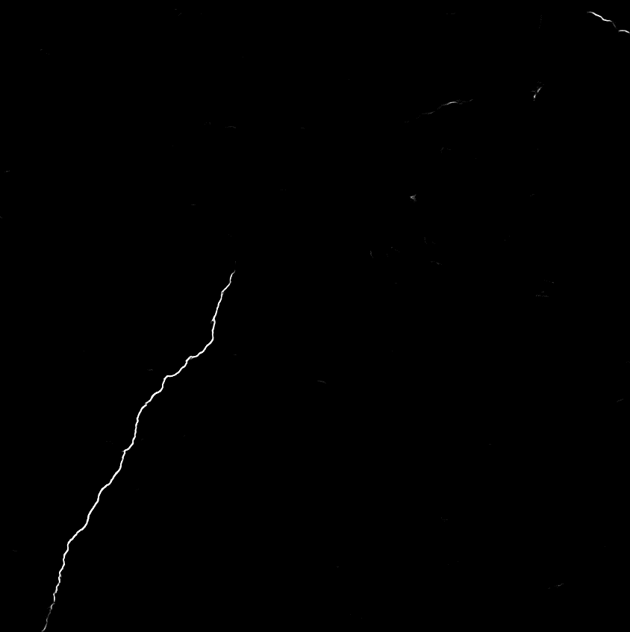

Two types of tasks
Segmentation
Longitudinal crack
Input
Detection

Slide 15
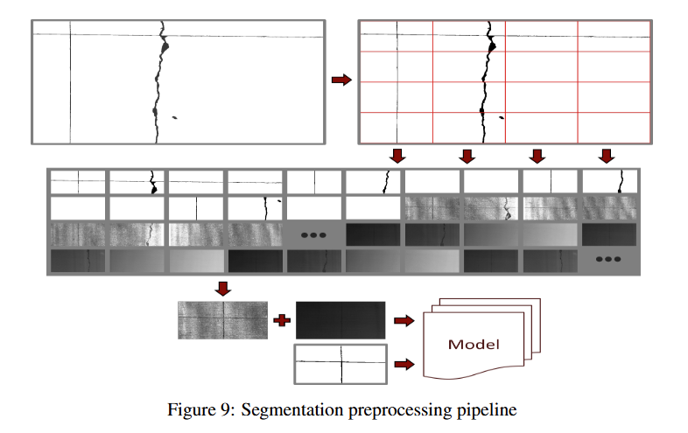
Segmentation dataset

Slide 16
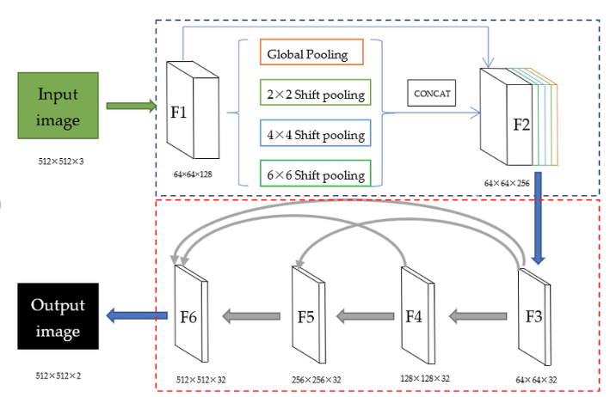
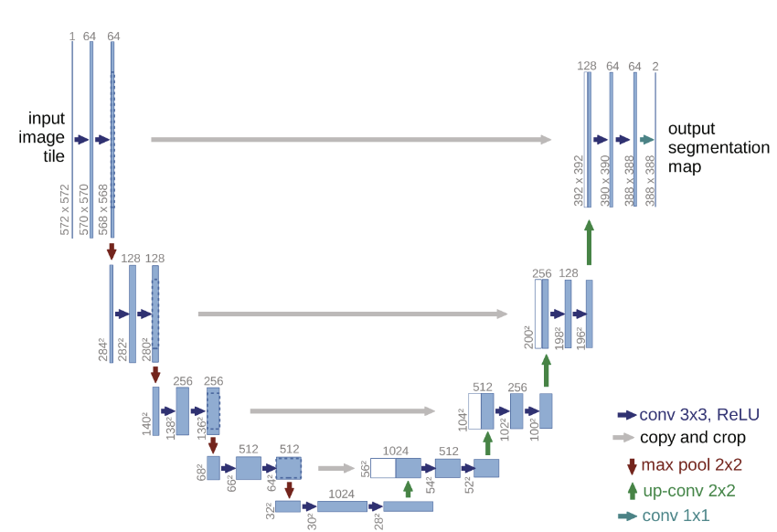
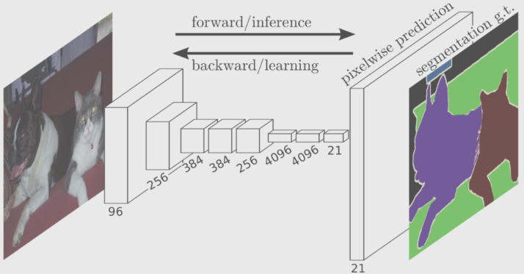
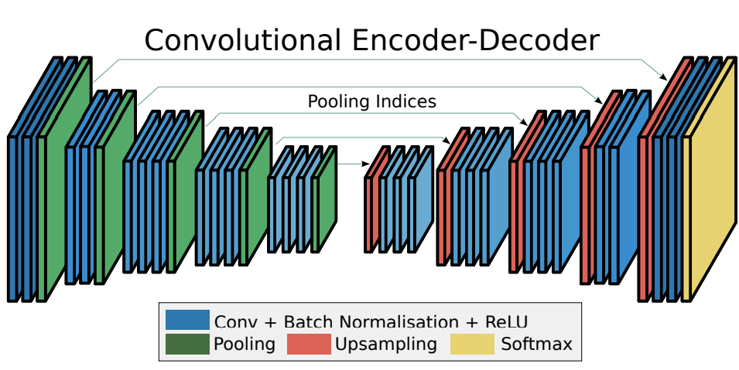
Segmentation
Methods:
U-Net
FCN
PSPNet
SegNet
PSPNet
U-Net
FCN
SegNet

Slide 17
Performance Metrics
Main metrics:
Precision: in the aspect of False positive
Recall: in the aspect of False negative
F1: a balanced indicator between precision and recall
All metric scores range from 0 to 1, with higher values indicating better performance.

Slide 18
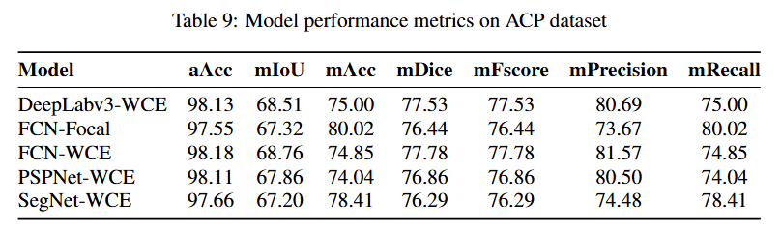
Segmentation - ACP
All models show close performance, with F1 score (mFscore) around 77% across the board
FCN-WCE achieves the highest F1-score (mFscore = 77.78) and precision (81.57)

Slide 19
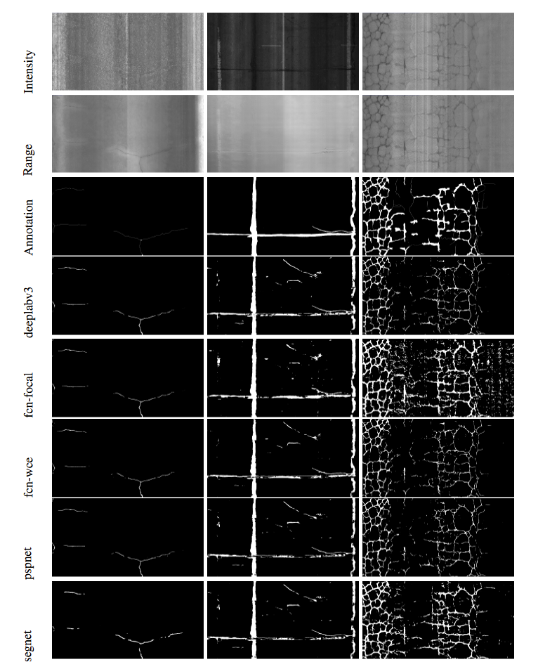
Segmentation - ACP
Good Performance with Clear Cracks:
Accurate segmentation for clear, well-defined cracks with distinct boundaries.
Poor Performance with Sealed and Alligator Cracks:
Incomplete or fragmented detection for sealed and complex alligator cracks.
False Positives Due to Complex Background

Slide 20
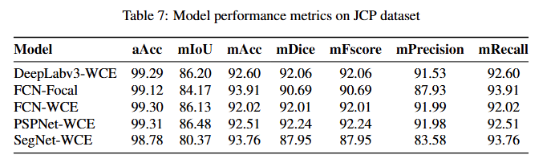
Segmentation - JCP
All models show close performance, with F1 score (mFscore) around 90% across the board
PSPNet-WCE achieves the highest F1-score (mFscore = 92.24)
Performance is significantly better than that of ACP

Slide 21
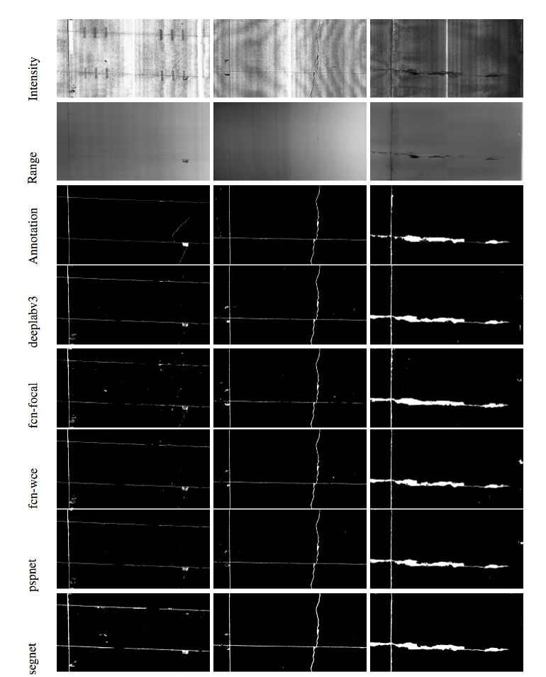
Segmentation - JCP
Good Performance with Clear Cracks:
Accurate segmentation for clear, well-defined cracks with distinct boundaries.
Poor Performance with thin cracks:
Incomplete or fragmented detection for thin cracks.
Much less False Positives compared to ACP

Slide 22
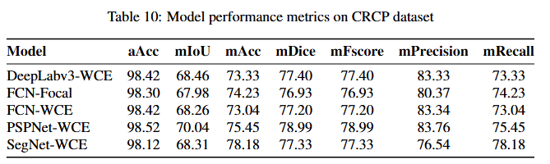
Segmentation - CRCP
All models show close performance, with F1 score (mFscore) around 77% across the board
PSPNet-WCE achieves the highest F1-score (mFscore = 78.99)
Performance is similar compared to ACP, significantly lower than JCP

Slide 23
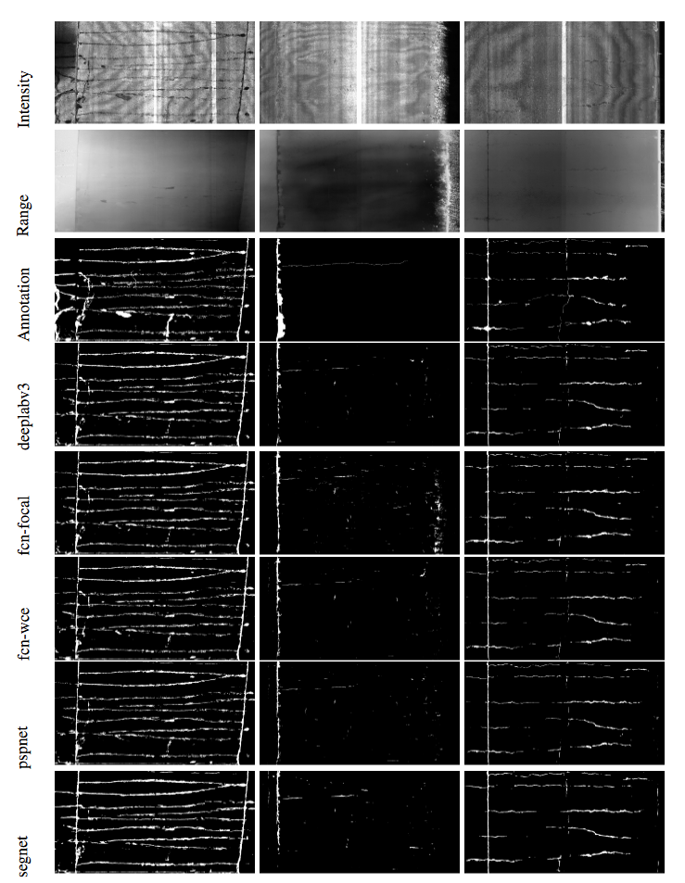
Segmentation - CRCP
Good Performance with Clear Cracks:
Accurate segmentation for clear, well-defined cracks with distinct boundaries.
Poor Performance with Sealed and Thin Cracks:
Incomplete or fragmented detection for sealed and thin cracks.
False Positives Due to Complex Background

Slide 24
Segmentation
Summary:
Better performance with JCP (92.24%), compared to ACP (77.78%) and CRCP (78.99%)
Small sample size
Additional steps needed to satisfy TxDOT’s requirement

Slide 25
Distress Detection
After revision, a total of 12,123 images for distress detection are adopted for AI/ML model training.
Detection Annotation Summary
Annotation type | Pavement Type | Number of annotated images
Detection (Bounding box & distress class) | ACP | 5,201
McLennan | JCP | 6,922
Harrison | CRCP | -

Slide 26
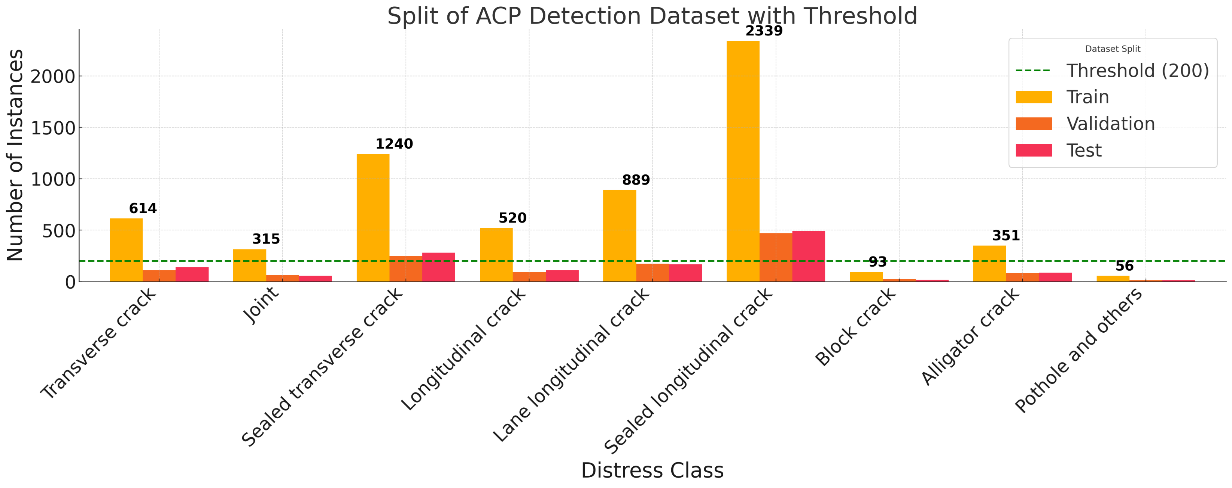
ACP Detection dataset
Train : Validation : Test = 70% : 15% : 15%
Imbalanced dataset
Block cracks and Potholes and others under 200

Slide 27
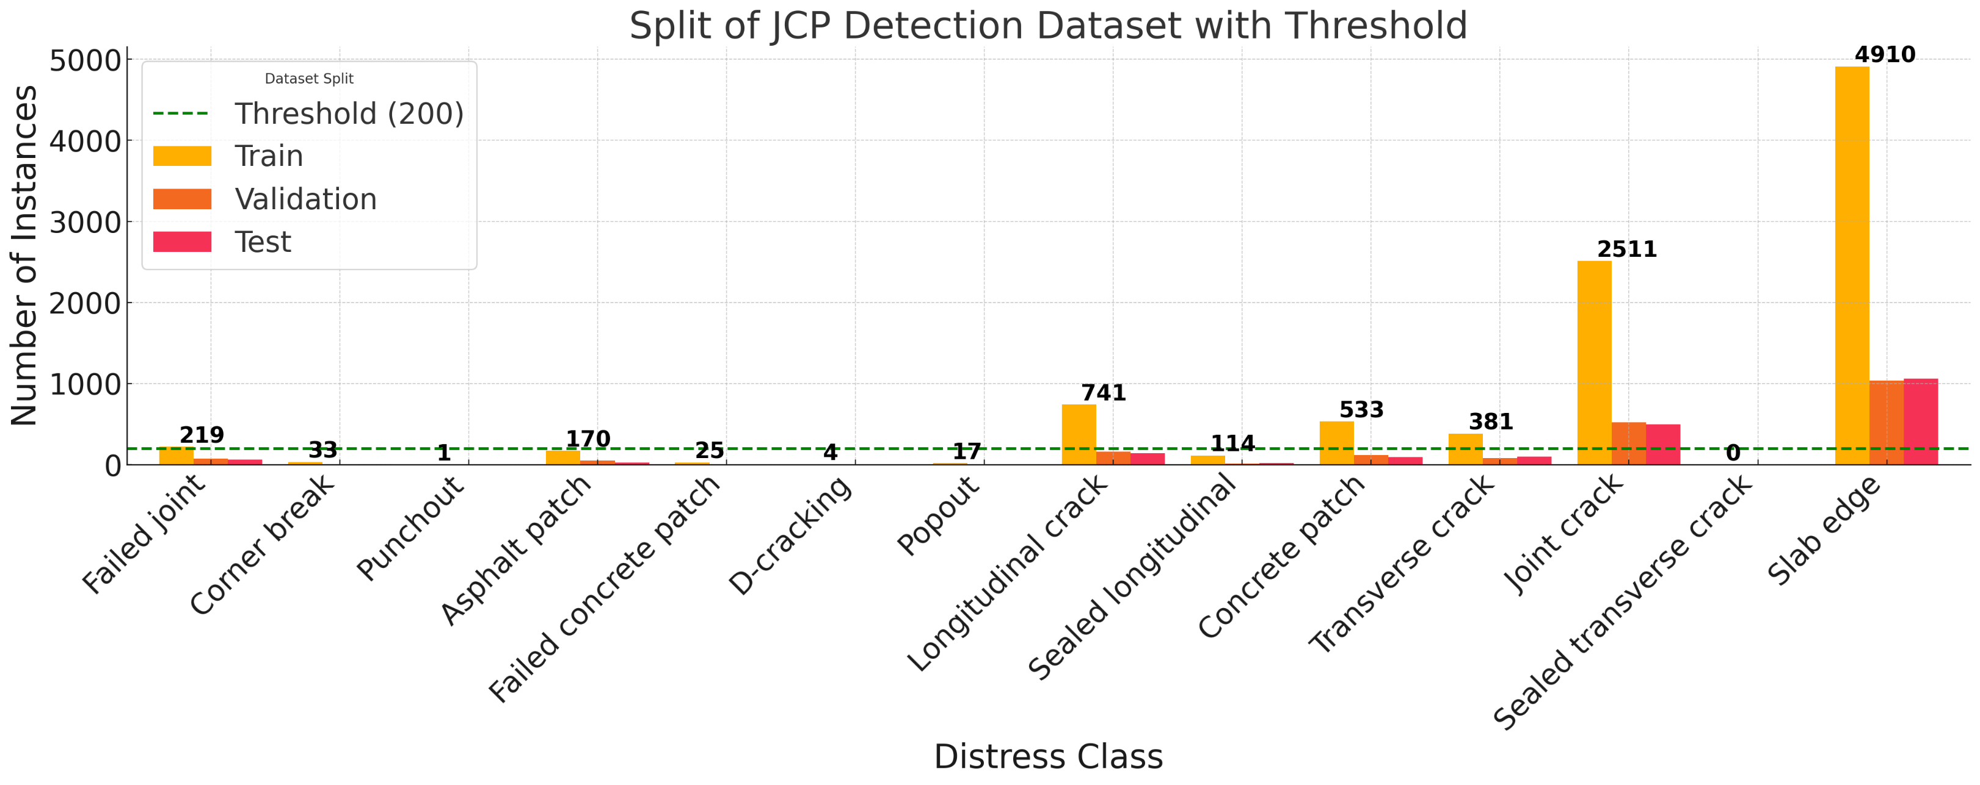
JCP Detection dataset
Train : Validation : Test = 70% : 15% : 15%
Imbalanced dataset
7 distress classes with instance number under 200

Slide 28
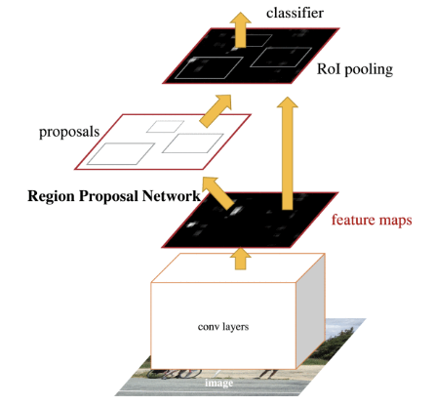
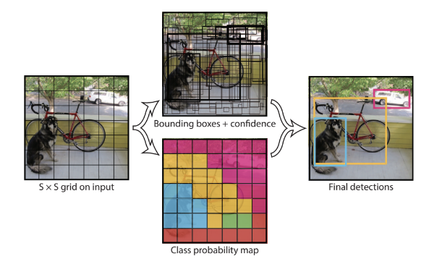
Distress Detection
Methods:
One-stage methods (YOLO)
Two-stage methods (Faster R-CNN)

Slide 29
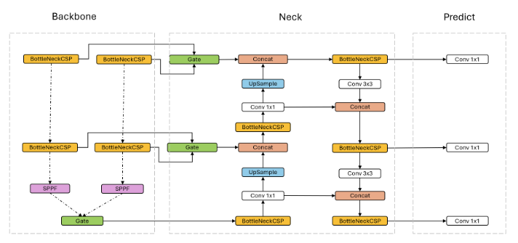
Distress Detection
Proposed methods:
MoPac
Attention-based neural network

Slide 30
Performance Metrics
Main metrics:
Precision: in the aspect of False positive
Recall: in the aspect of False negative
F1: a balanced indicator between precision and recall
mAP: a more comprehensive metric, considering the model's precision and recall across multiple thresholds

Slide 31
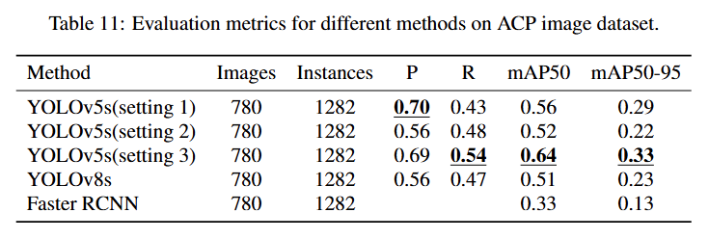
Detection - ACP
Experiment setting:
YOLOv5s(setting 1) : Original size + single channel input + anchor
YOLOv5s(setting 2) : Original size + single channel input
YOLOv5s(setting 3) : Reduced size + three-channel input + anchor

Slide 32
Detection - ACP
Performance:
YOLOv5s(setting 3) yielded the best mAP (0.64) by a large margin
YOLOv8 performed worse than YOLOv5
Faster RCNN yielded the lowest performance

Slide 33
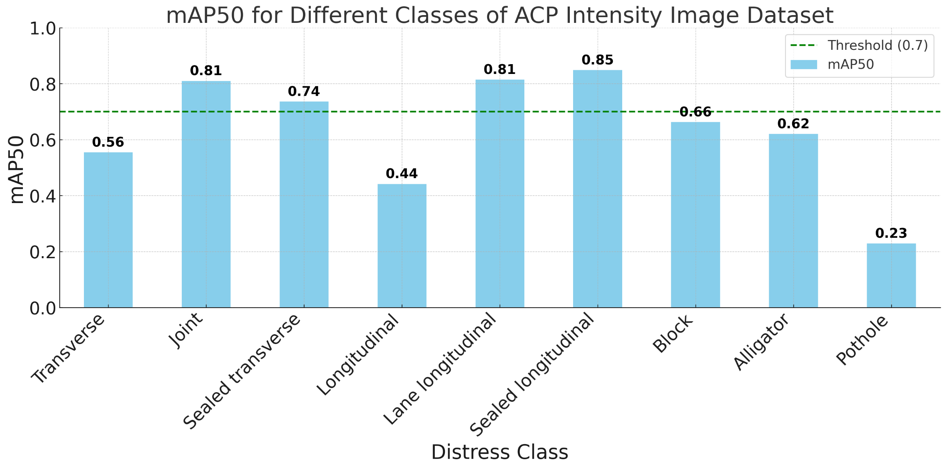
Detection - ACP
High mAP50 scores for Joint, Lane longitudinal, and Sealed longitudinal
Lower mAP50 scores for classes like Pothole (0.23), Longitudinal (0.44), and Transverse (0.56)
Not enough sample
Barely visible cracks?

Slide 34
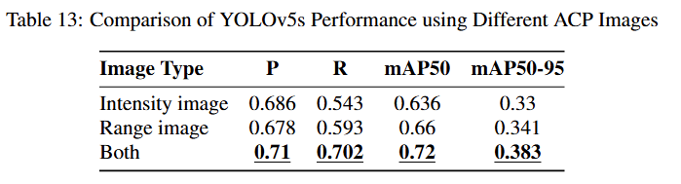
Detection - ACP
Combined Image Types:
Achieves highest overall performance across metrics
Precision: 0.71 | Recall: 0.702
mAP50: 0.72 | mAP50-95: 0.383
Insight:
Merging intensity and range images enhances YOLOv5s detection accuracy effectively

Slide 35
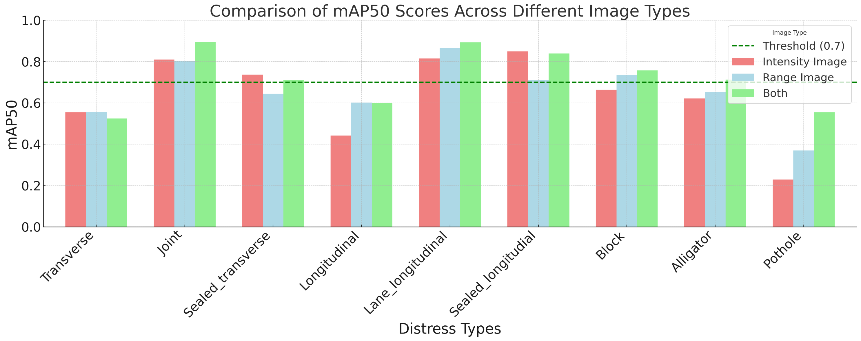
Detection - ACP
Observations:
Majorities of distress classes improved
Performance of Transverse crack detection drops
mAP50 of Transverse and Longitudinal cracks are still below 0.7

Slide 36
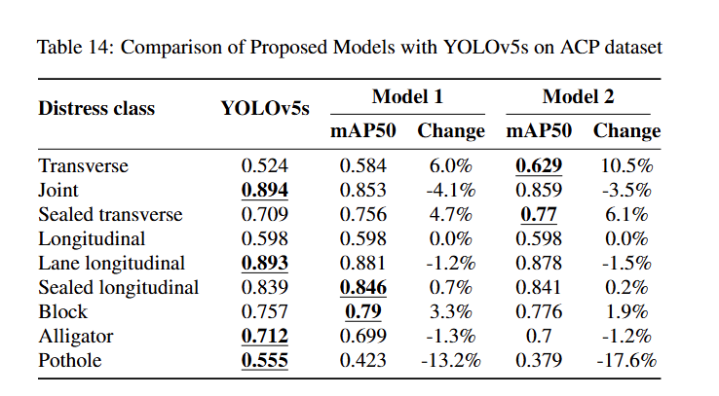
Detection - ACP
Propose model:
Significantly improved the performance of Transverse and Sealed transverse detection
Caused a slight performance drop of other distress classes
Further actions required

Slide 37
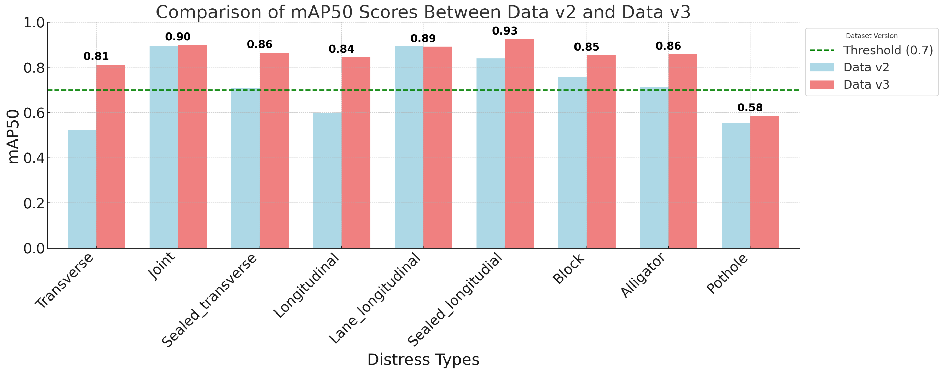
Detection – ACP (latest progress)
A new dataset (Data v3) developed by adding a small portion of 2023 psi data into the original dataset (2022 psi data):
Detection performance of all distress classes improved
All mAP scores passed 0.7 except Pothole (still not enough sample)

Slide 38
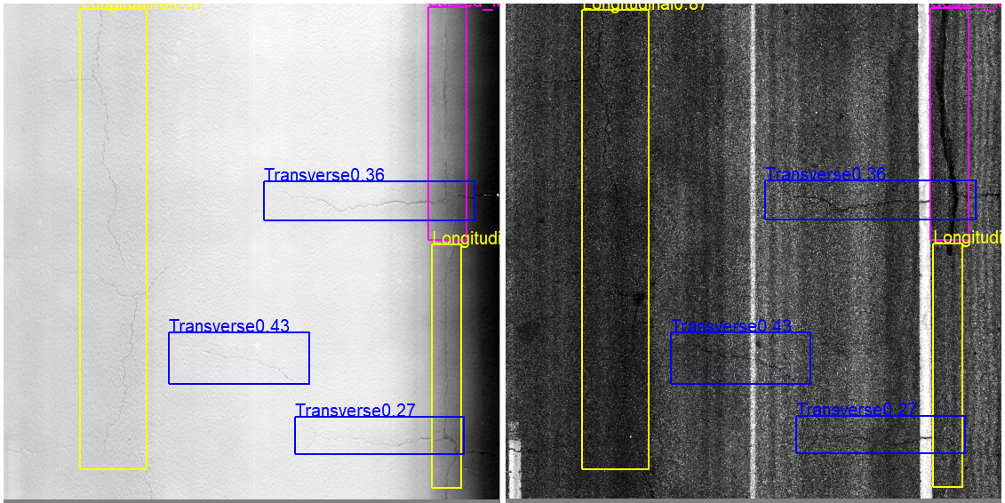
ACP detection sample

Slide 39
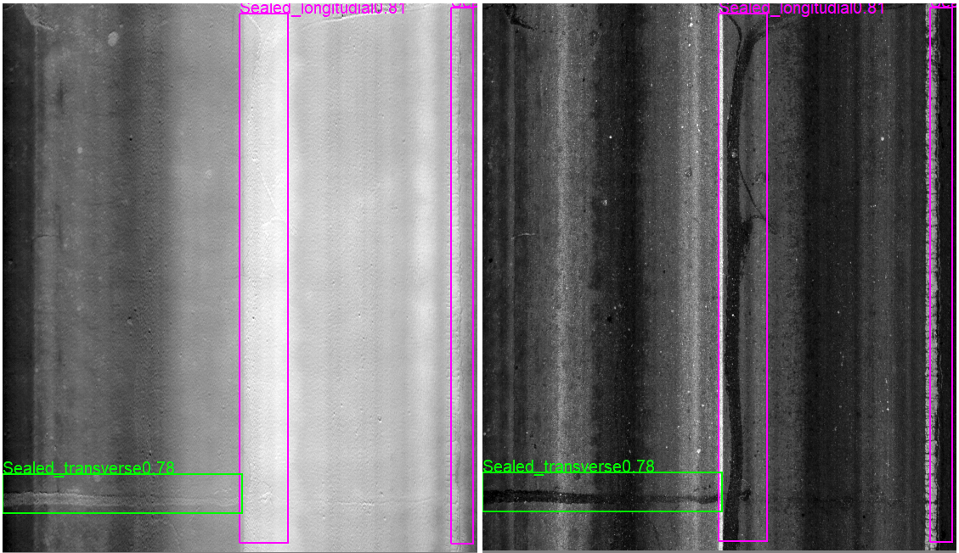
Detection - ACP

Slide 40
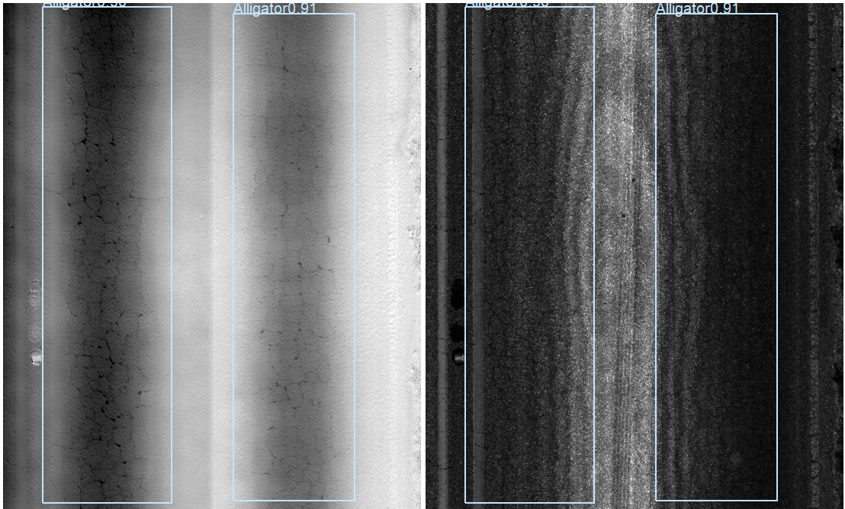
Detection - ACP

Slide 41
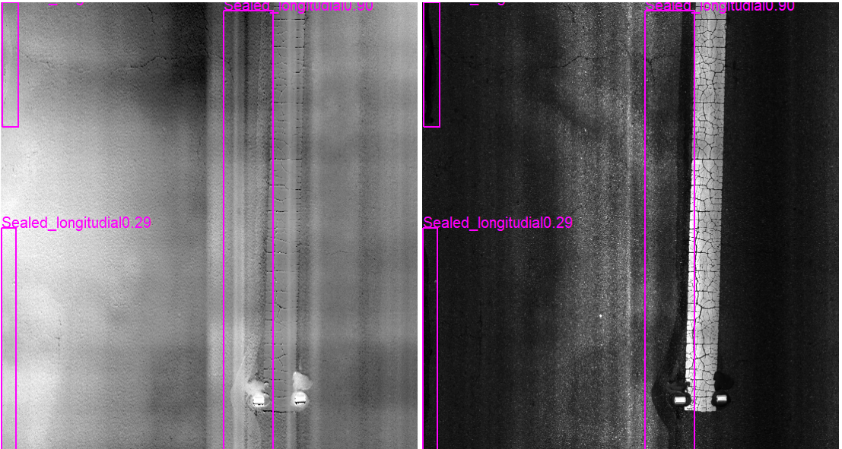
Detection - ACP
Missing detection

Slide 42
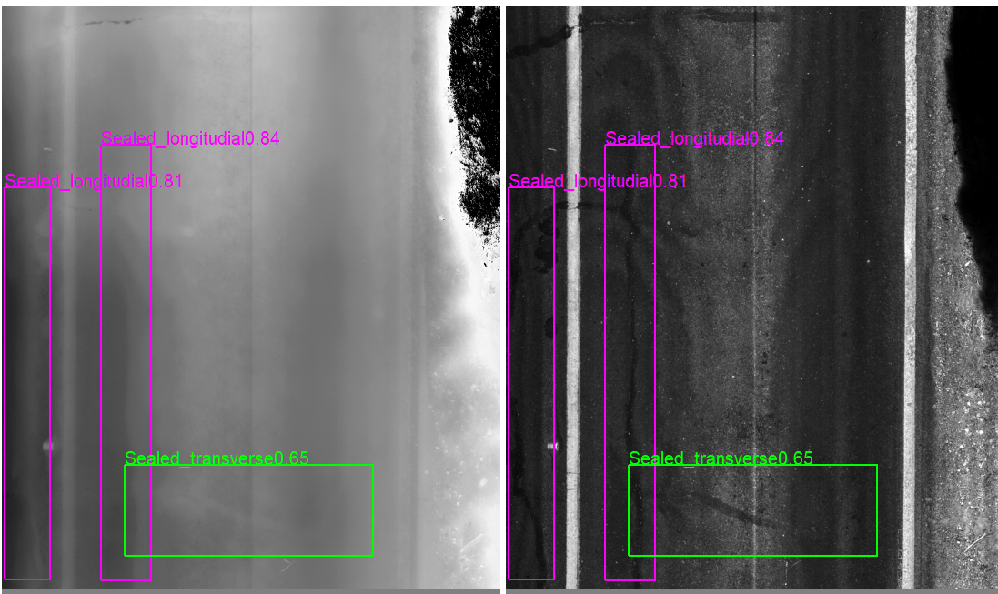
Detection - ACP
Missing detection

Slide 43
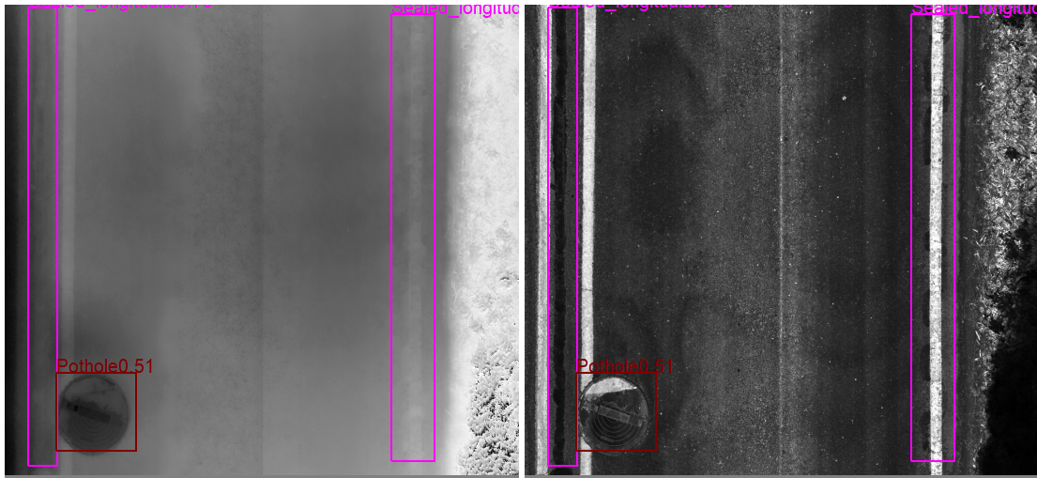
Detection - ACP
Wrong detection

Slide 44
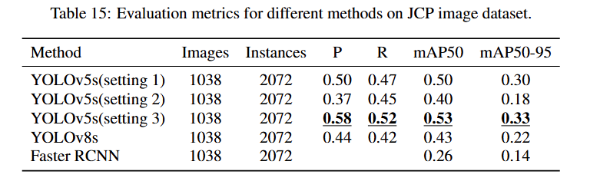
Detection - JCP
Experiment setting:
YOLOv5s(setting 1) : Original size + single channel input + anchor
YOLOv5s(setting 2) : Original size + single channel input
YOLOv5s(setting 3) : Reduced size + three-channel input + anchor

Slide 45
Detection - JCP
Experiment setting:
YOLOv5s(setting 3) yielded the best mAP (0.53)
YOLOv8 performed significantly worse than YOLOv5
Faster RCNN yielded the lowest performance

Slide 46
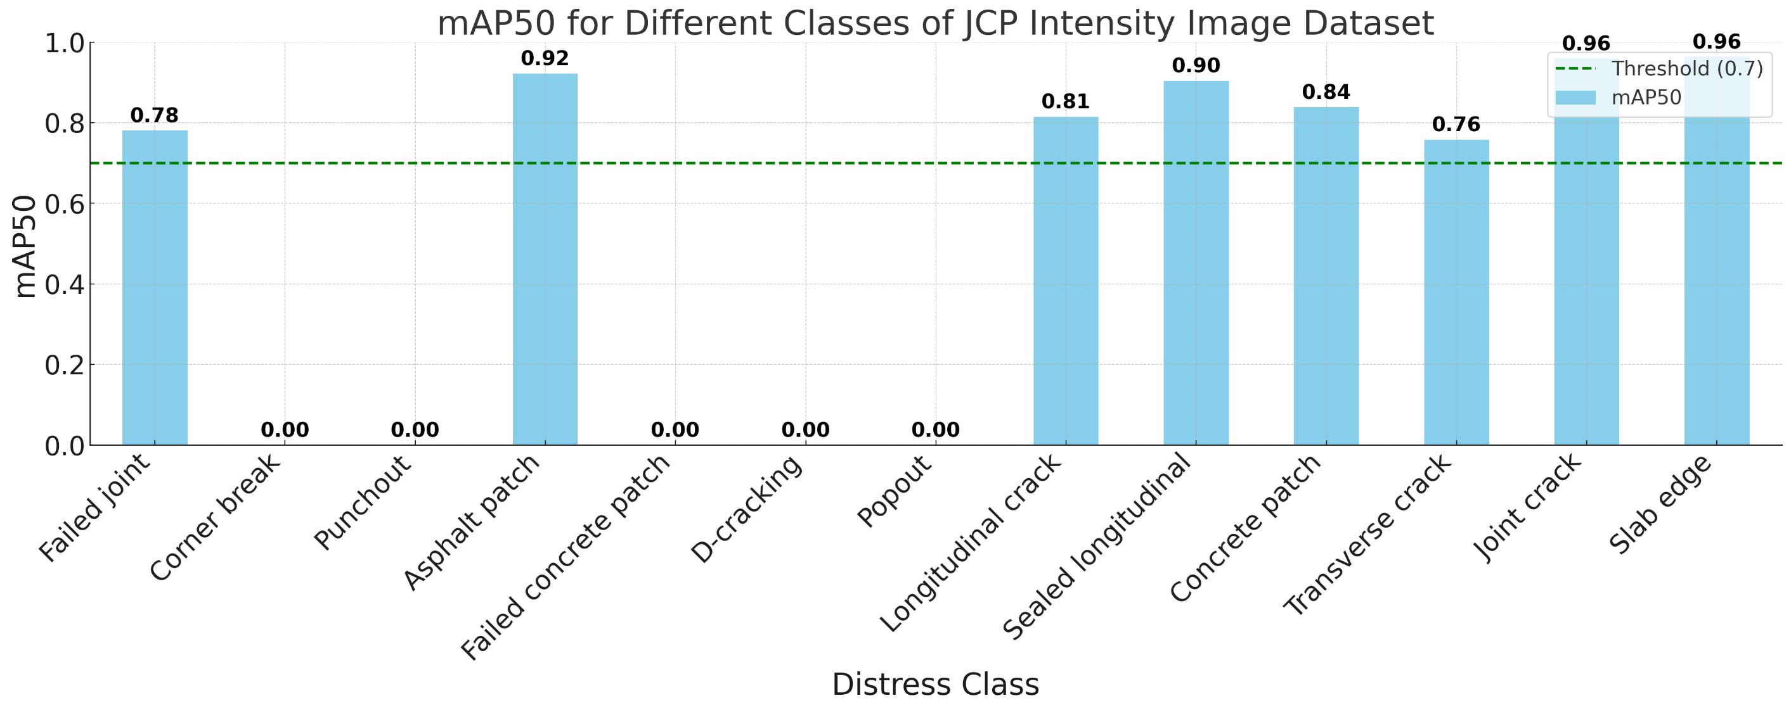
Detection - JCP
Key observations:
-mAP50 exceeds the 0.7 threshold for most classes
The rest of classes have the mAP of 0.0
Insight: underrepresented distress classes
Not enough sample

Slide 47
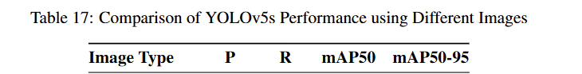
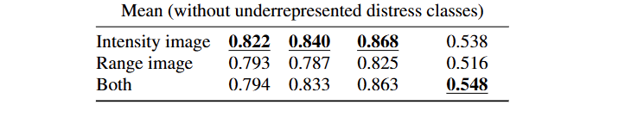
Detection - JCP
Observations:
Using only intensity images yielded the best performance (different from ACP)
Precision: 0.82 | Recall: 0.84
mAP50: 0.87
Insight:
Most distresses are visible in the intensity image alone

Slide 48
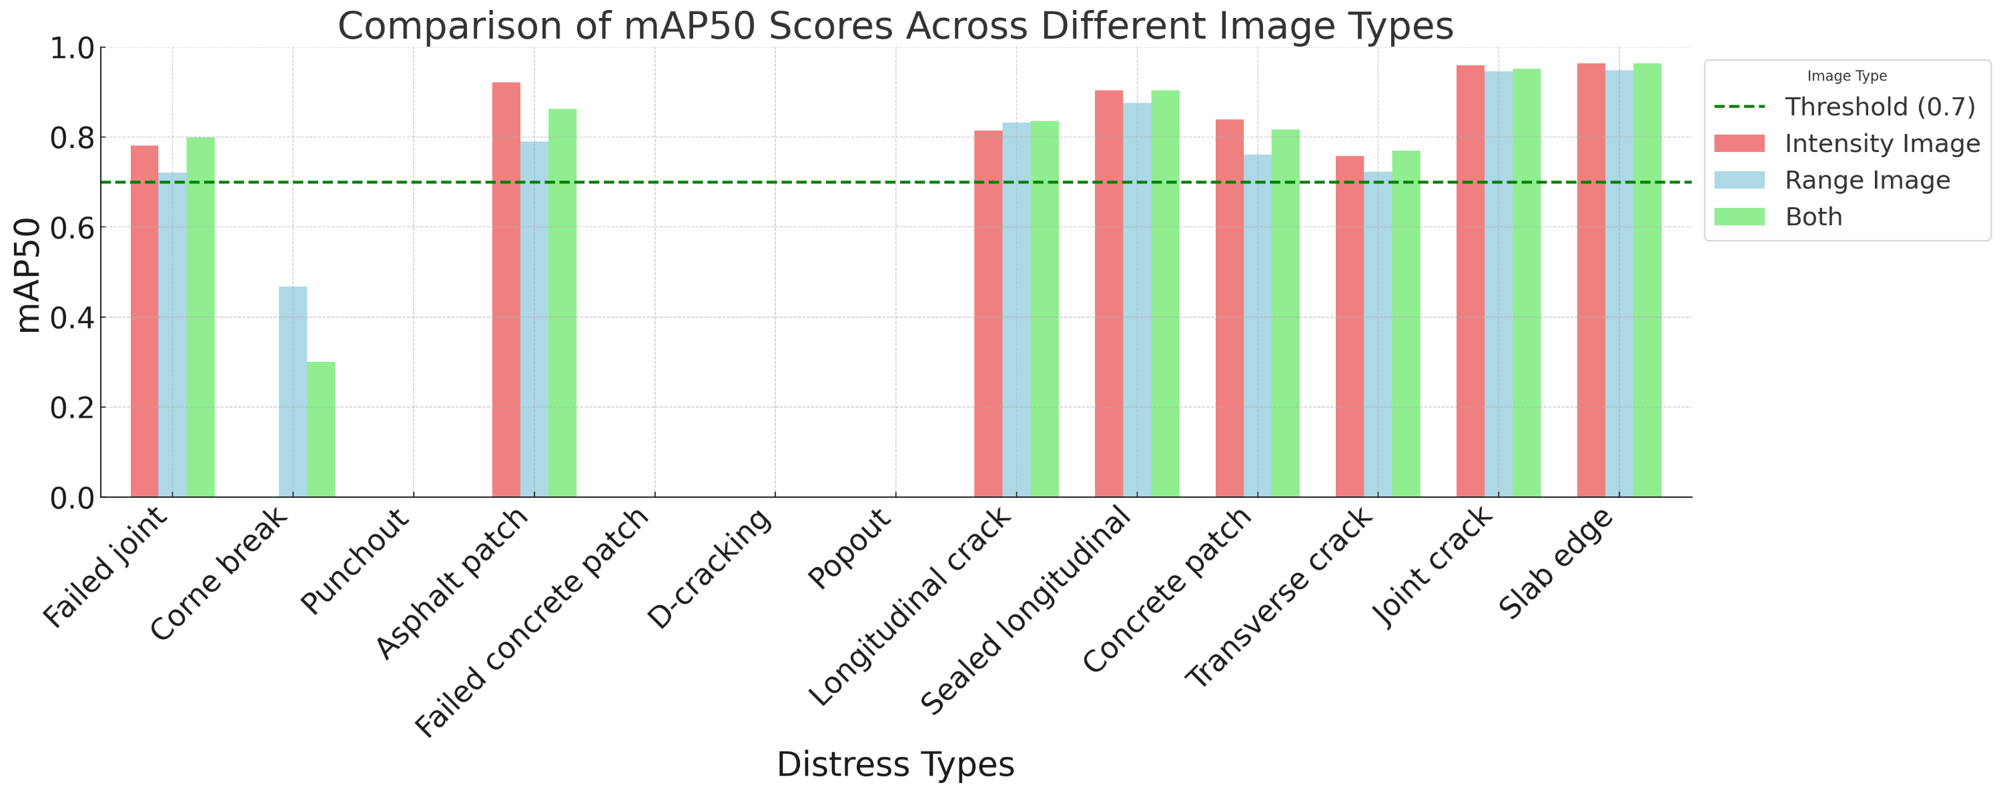
Detection - JCP
Observations:
Using both intensity and range image does not significantly improve the performance
Using intensity only is better than using range only (very interesting)
More data may be needed

Slide 49
Comparison with PathView
Factors contributing to difference (according to manual visual check):
Wrong detection/classification
Different perceptions of cracks
Different data postprocessing

Slide 50
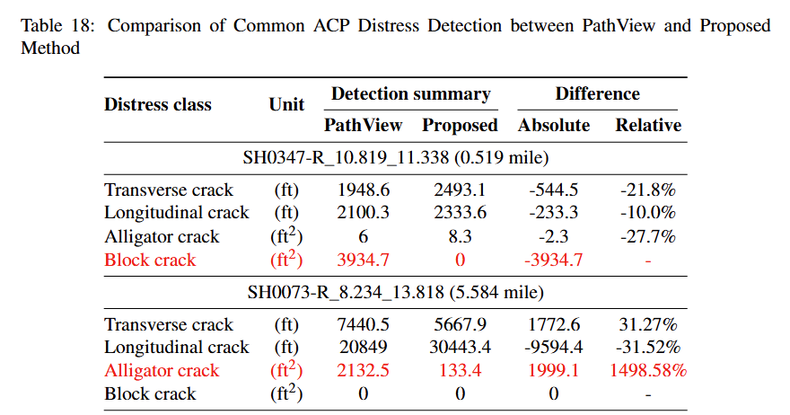
Comparison with PathView

Slide 51
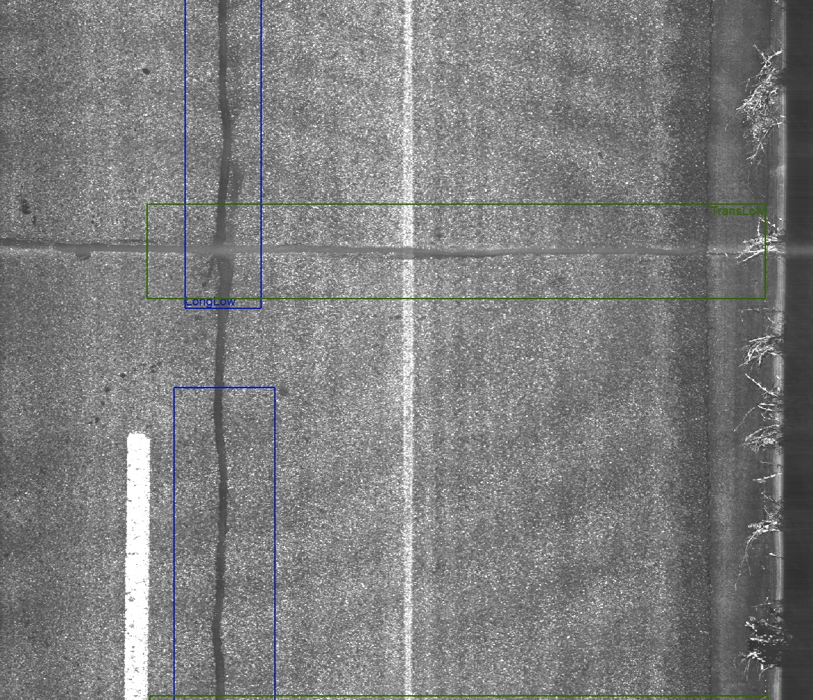
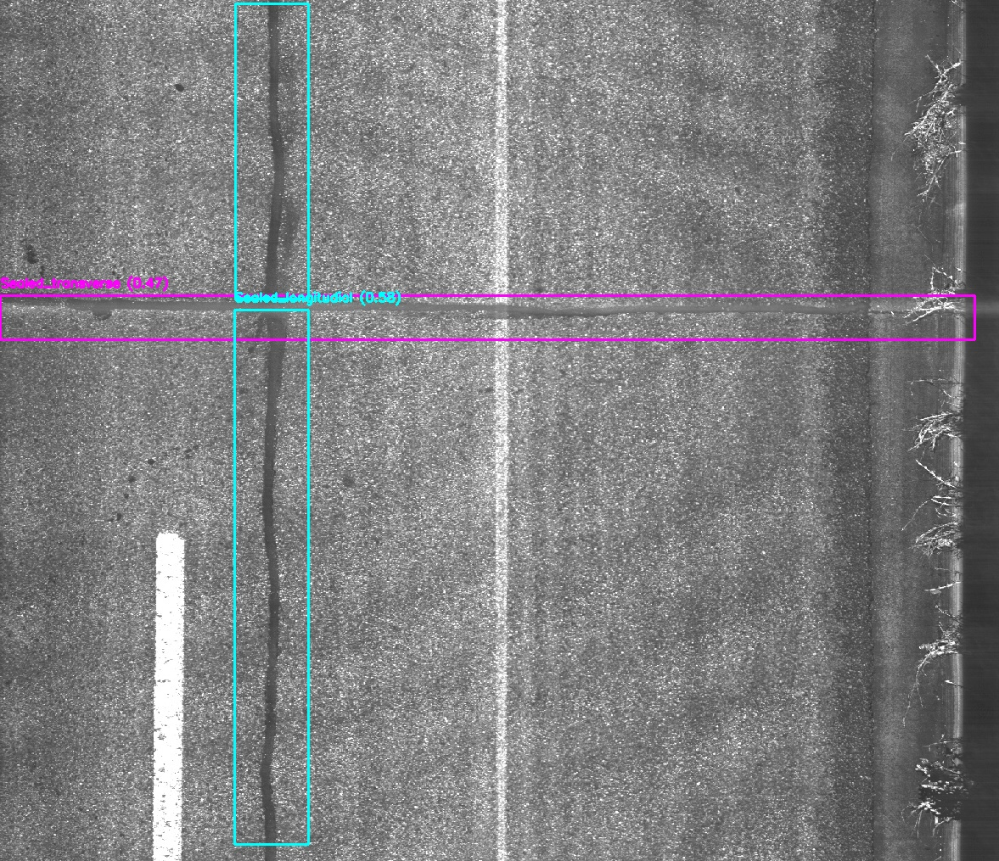
Comparison with PathView
Source: SH0347_R_10.819_11.338
False
negative
PathView
Proposed method

Slide 52
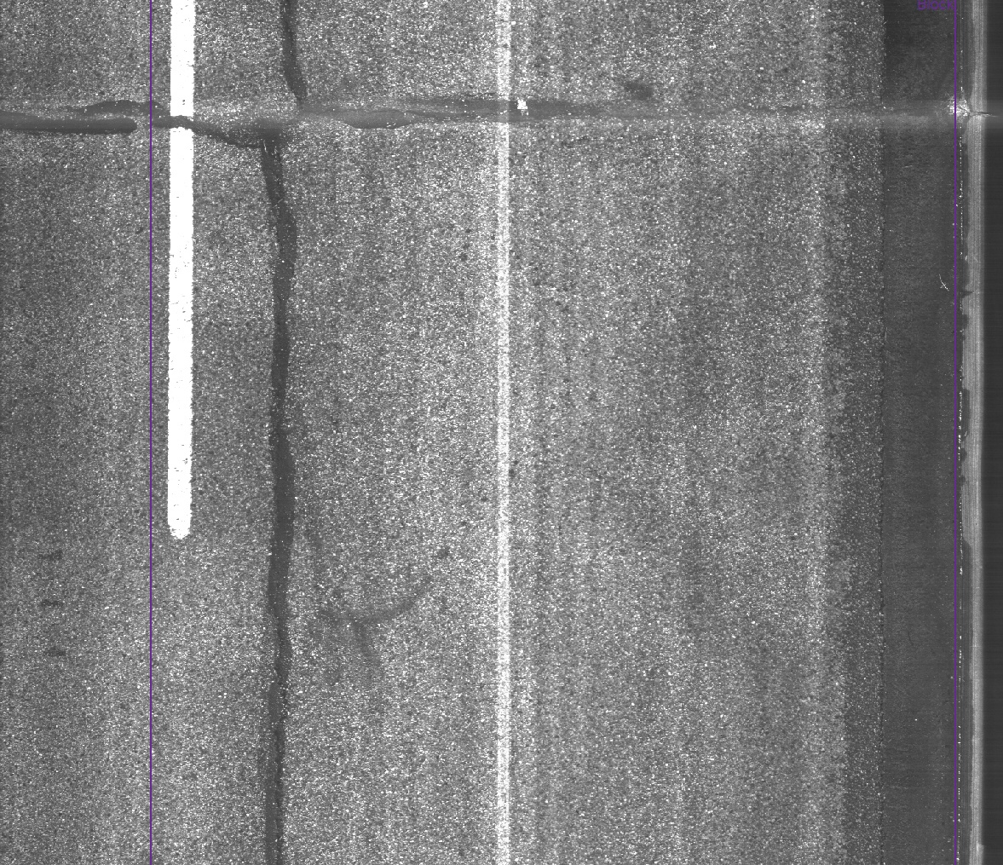
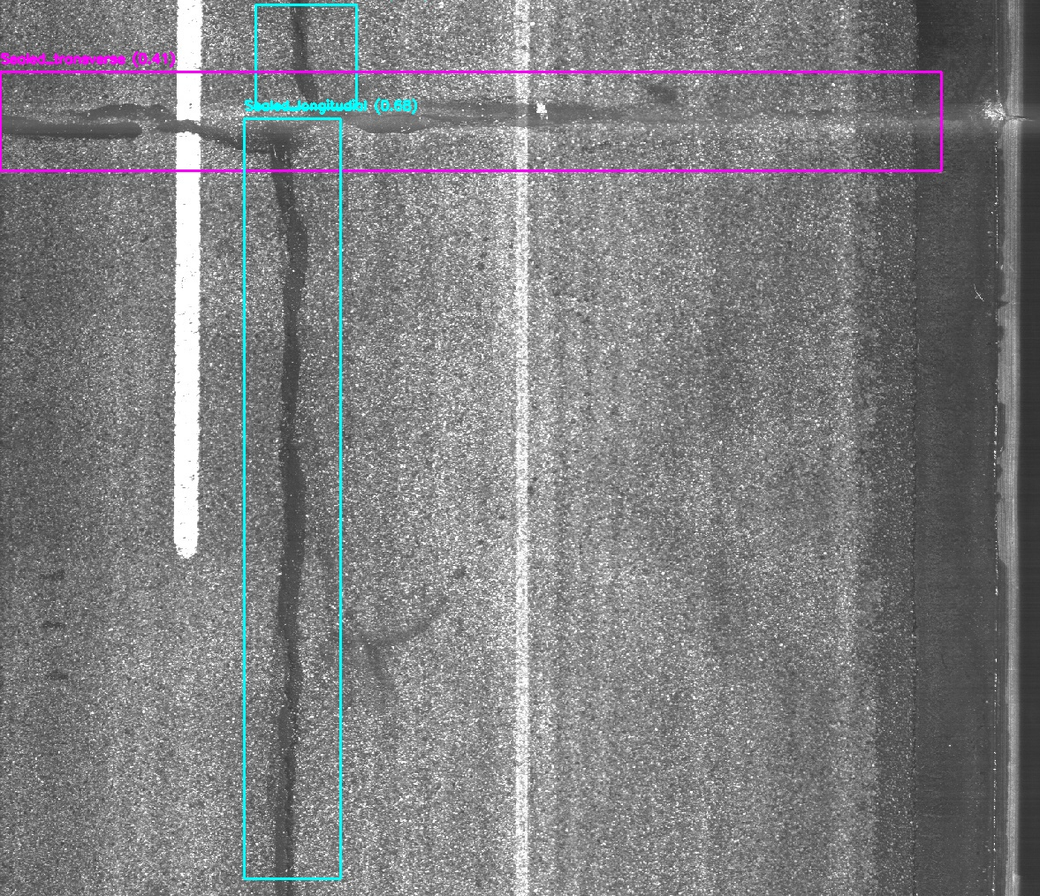
Comparison with PathView
Source: SH0347_R_10.819_11.338
False
Class
PathView
Proposed method

Slide 53
Comparison with PathView

Slide 54
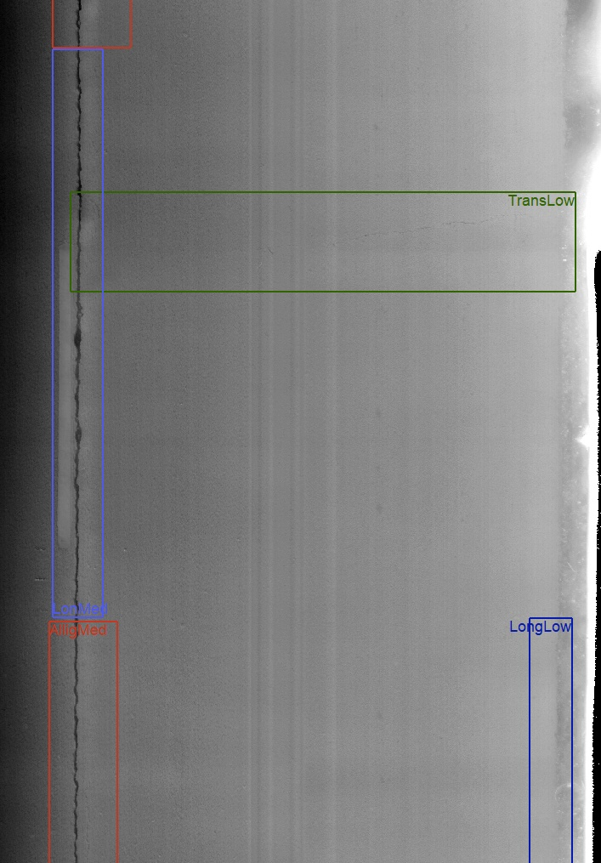
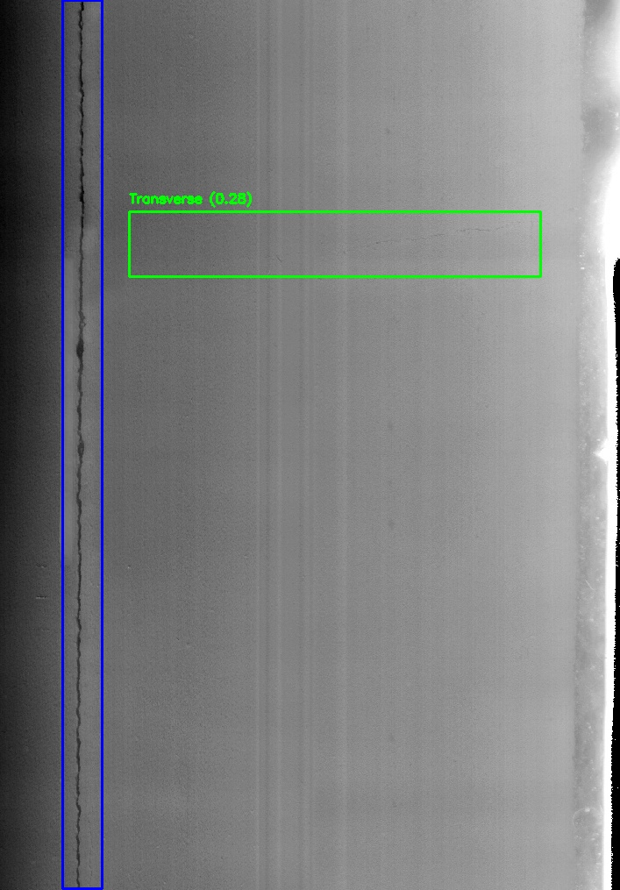
Comparison with PathView
False
class
Source: SH0073_R_8.234_13.818
False
class
False
positive
PathView
Proposed method

Slide 55
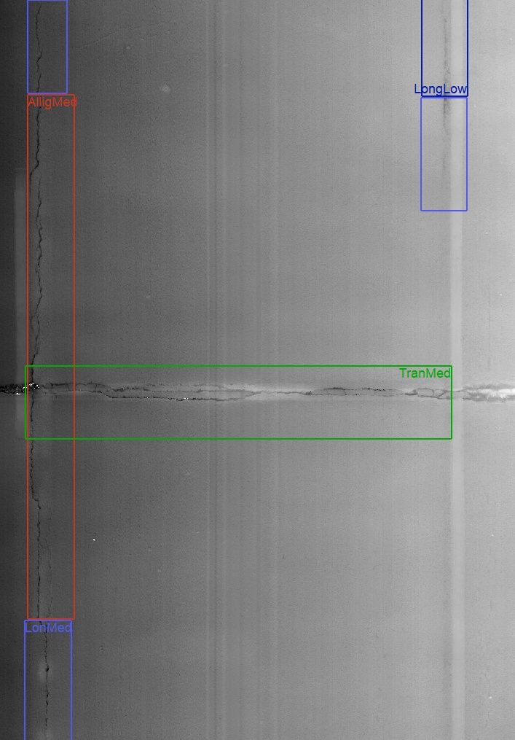
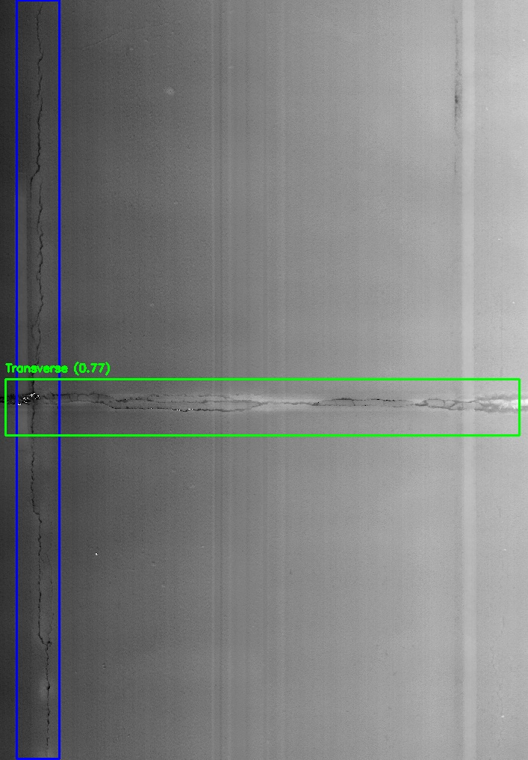
Comparison with PathView
Source: SH0073_R_8.234_13.818
False
negative
False
class
PathView
Proposed method

Slide 56


Comparison with PathView
Source: SH0073_R_8.234_13.818
False
positive
False
negative
PathView
Proposed method

Slide 57


Comparison with PathView
Source: SH0073_R_8.234_13.818
False
positive
False
negative
False
positive
PathView
Proposed method

Slide 58


Comparison with PathView
Source: SH0073_R_8.234_13.818
False
positive
False
positive
PathView
Proposed method

Slide 59


Distress Detection Tool (Demo)

Slide 60
AGENDA
1
Tasks Overview
2
Task 5 updates
3
Future Work
4
Q & A

Slide 61

Future Work
Milestone
Next Step?
We are here

Slide 62
Future Work
Task 6
Complimentary data annotation
Further model development

Slide 63
AGENDA
1
Tasks Overview
2
Task 5 updates
3
Future Work
4
Q & A

Slide 64
Q & A

